Slide 1
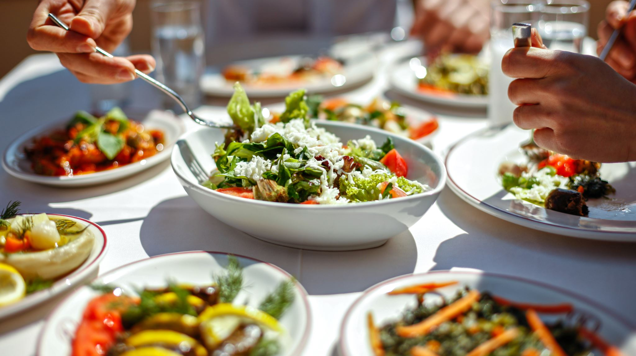

Michelin-Starred Restaurants Across the Globe - Beat the hunger.

Slide 2


INTRODUCTION
Restaurants are awarded stars in the Michelin Guide, an international restaurant guide, in recognition of their exceptional cuisine offerings. Travelers frequently seek out these starred restaurants since they are regarded as some of the greatest in the world. The eating options are recommended by the guide based on several characteristics, such as name, address, location, cuisine, latitude, longitude, phone number, URL, award, and lowest and highest pricing.

Slide 3
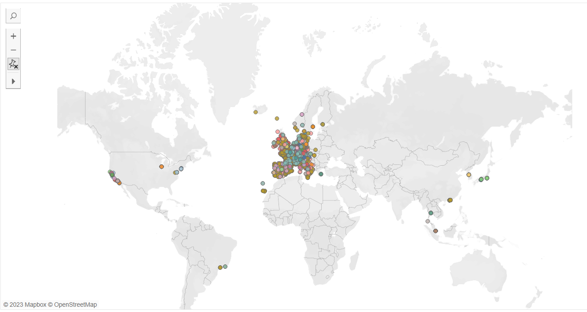
Geographical Distribution of Restaurants

Slide 4
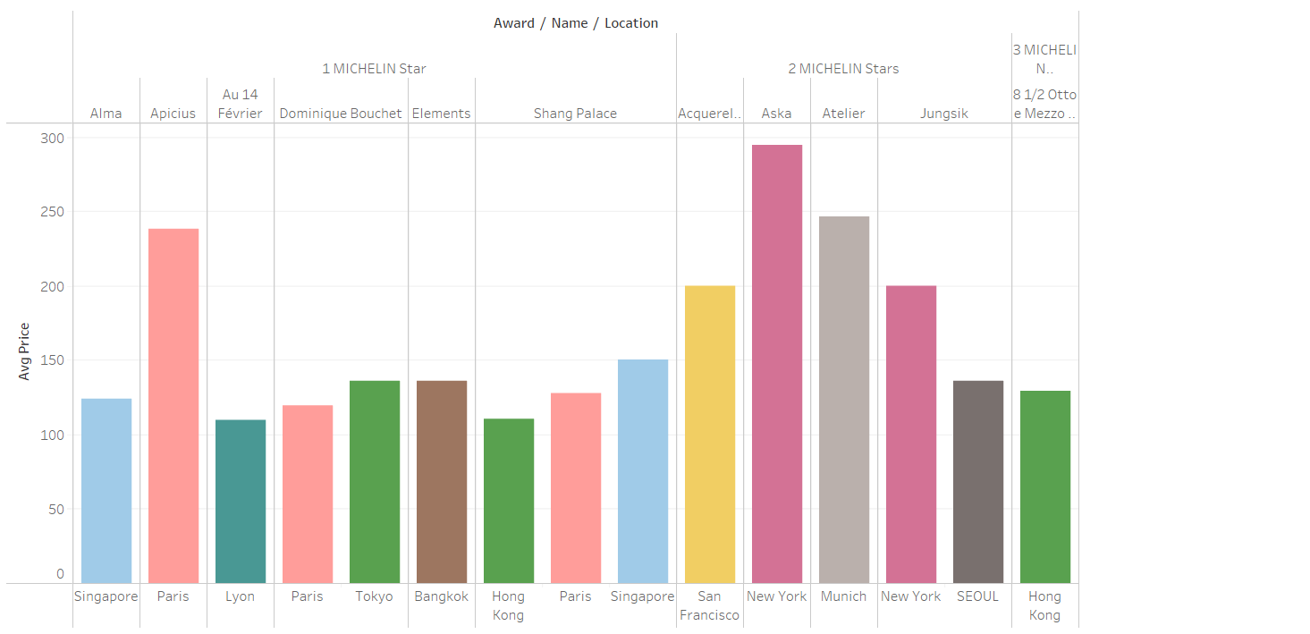
Average Price by Award of Top 20 cuisines

Slide 5
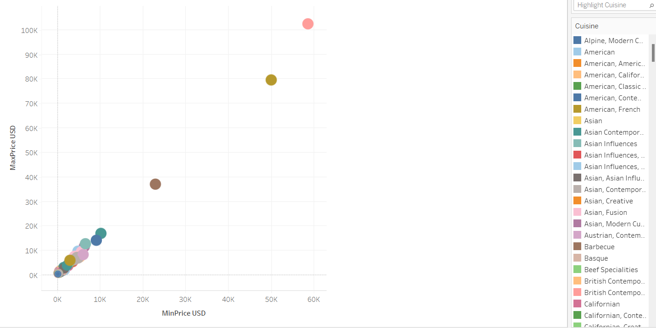
Cuisine by Max and Min Prices

Slide 6
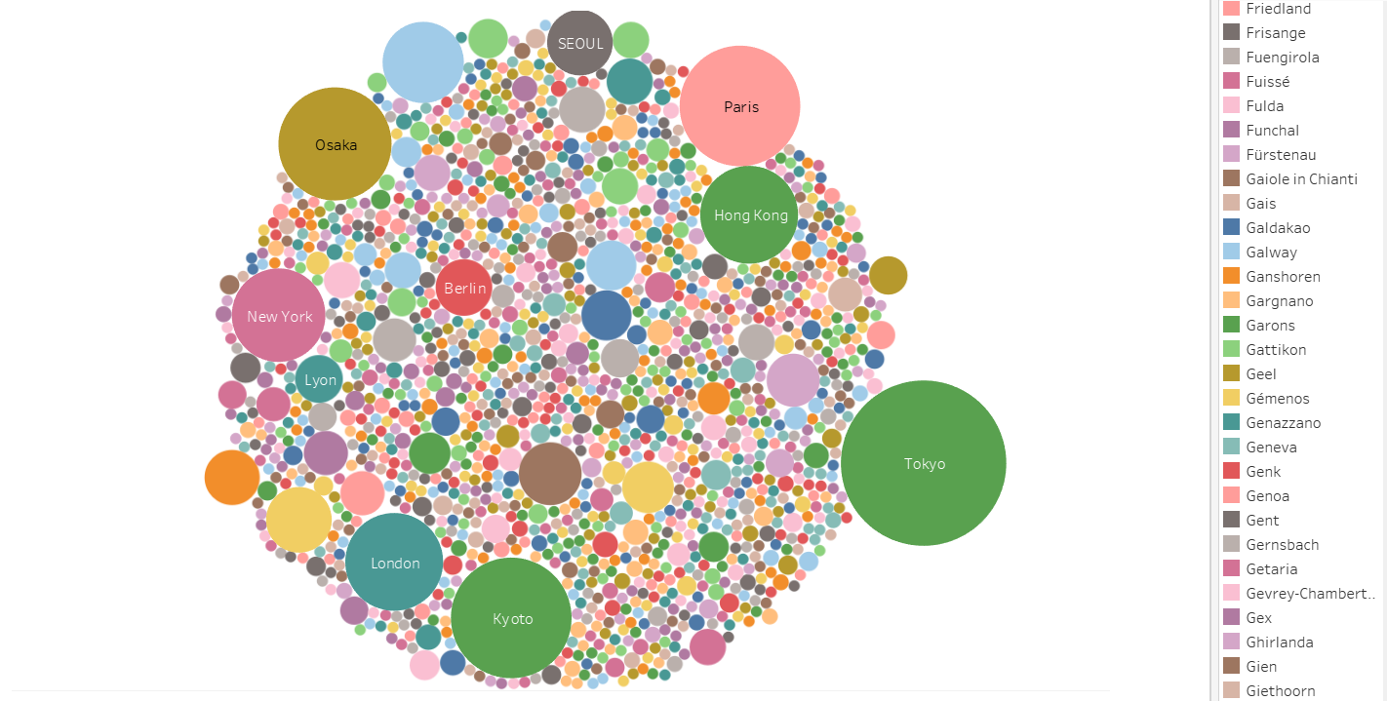
Total number of awards for each location

Slide 7
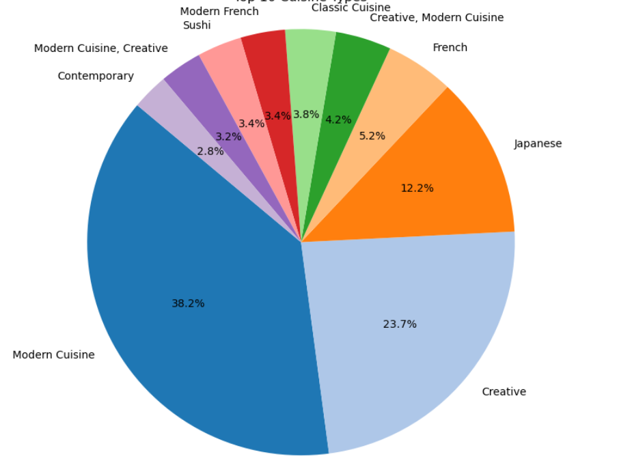
Top 10 cuisine types

Slide 8
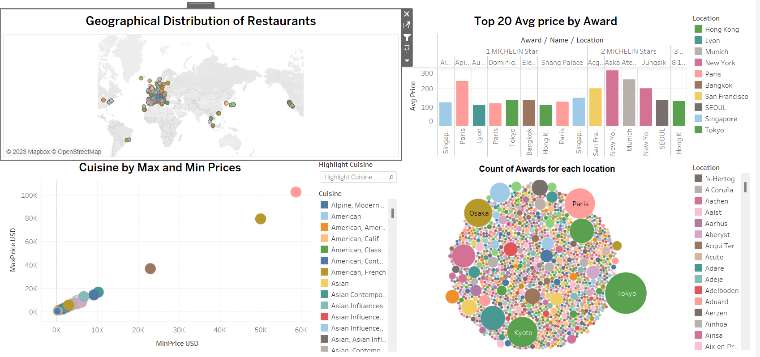
Interactive Dashboard

Slide 9

CONCLUSION
In conclusion, the analysis of the "Michelin-Starred Restaurants" reveals several key insights into the cuisine landscape. Geographically, Michelin-starred restaurants are concentrated in Europe and Asia, with notable clusters in Switzerland, France, Spain, Italy, and Japan. Price patterns vary significantly by city and cuisine, with higher prices generally associated with more Michelin stars and certain types of cuisine. The top cuisine types are modern, creative, and Japanese, reflecting global trends in culinary preferences.

Slide 10

Thank you

